Slide 1
BLOT—Body Line of Thought
Visual Story

Slide 2
What information is in this visual story?
You can click on the things you want to know about
Location / Schedule
The story
The set
The performers
Lights / Video / Sound
Things you might find intense
Sound intensity chart

Slide 3
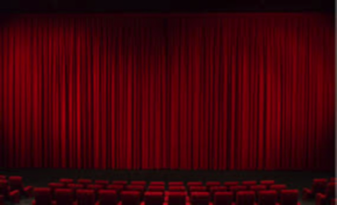
Location & Schedule
Exact date and time of the performance: 24th May 2025 at 19.00
Adress of the venue: Teatro delle Passioni, Via Antonio Peretti, 9, 41124 Modena, Italy
Visual description of the entrance in the space: The building of the theatre is yellow. The theatre is accessed from the square through an external corridor on the left side of the building.
Visual description of the performance studio: The hall is accessed from a corridor. On the right there is a modular staircase that can be opened or closed adding or removing seats according to need. The seats are water green and without armrest. The stage is at floor level without lifts. There is no curtain.
Total number of seats: The total number of seats with the staircase open is 140, but can be reduced as needed. For the BLOT show there will be 84 seats, arranged in 6 rows with a central corridor.
Do they have numbers: Yes
Are there any special place where the neurodiverse people can be seated: Yes, in the seats on the central corridor (right and left) to facilitate the exit in case of need; the first row and the space in front of the first row is reserved for people with wheelchairs.
Can you make the access of neurodiverse audience after the rest of the audience is already seated, just prior to the start of the performance: Yes, if they report their presence to the theatre staff.
Can you organize a comfort zone? Yes
Visual description of the comfort zone: A slightly secluded place will be set up with seats, soft objects and water.

Slide 4
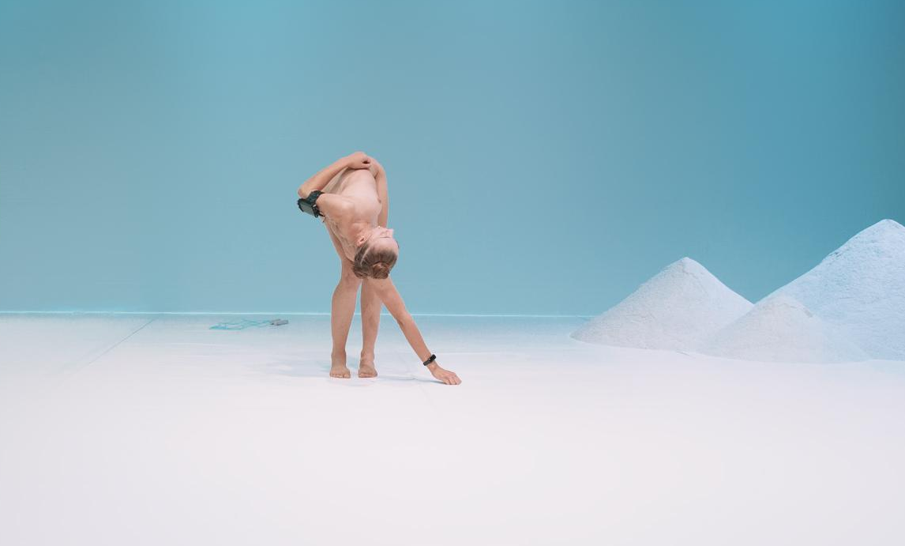
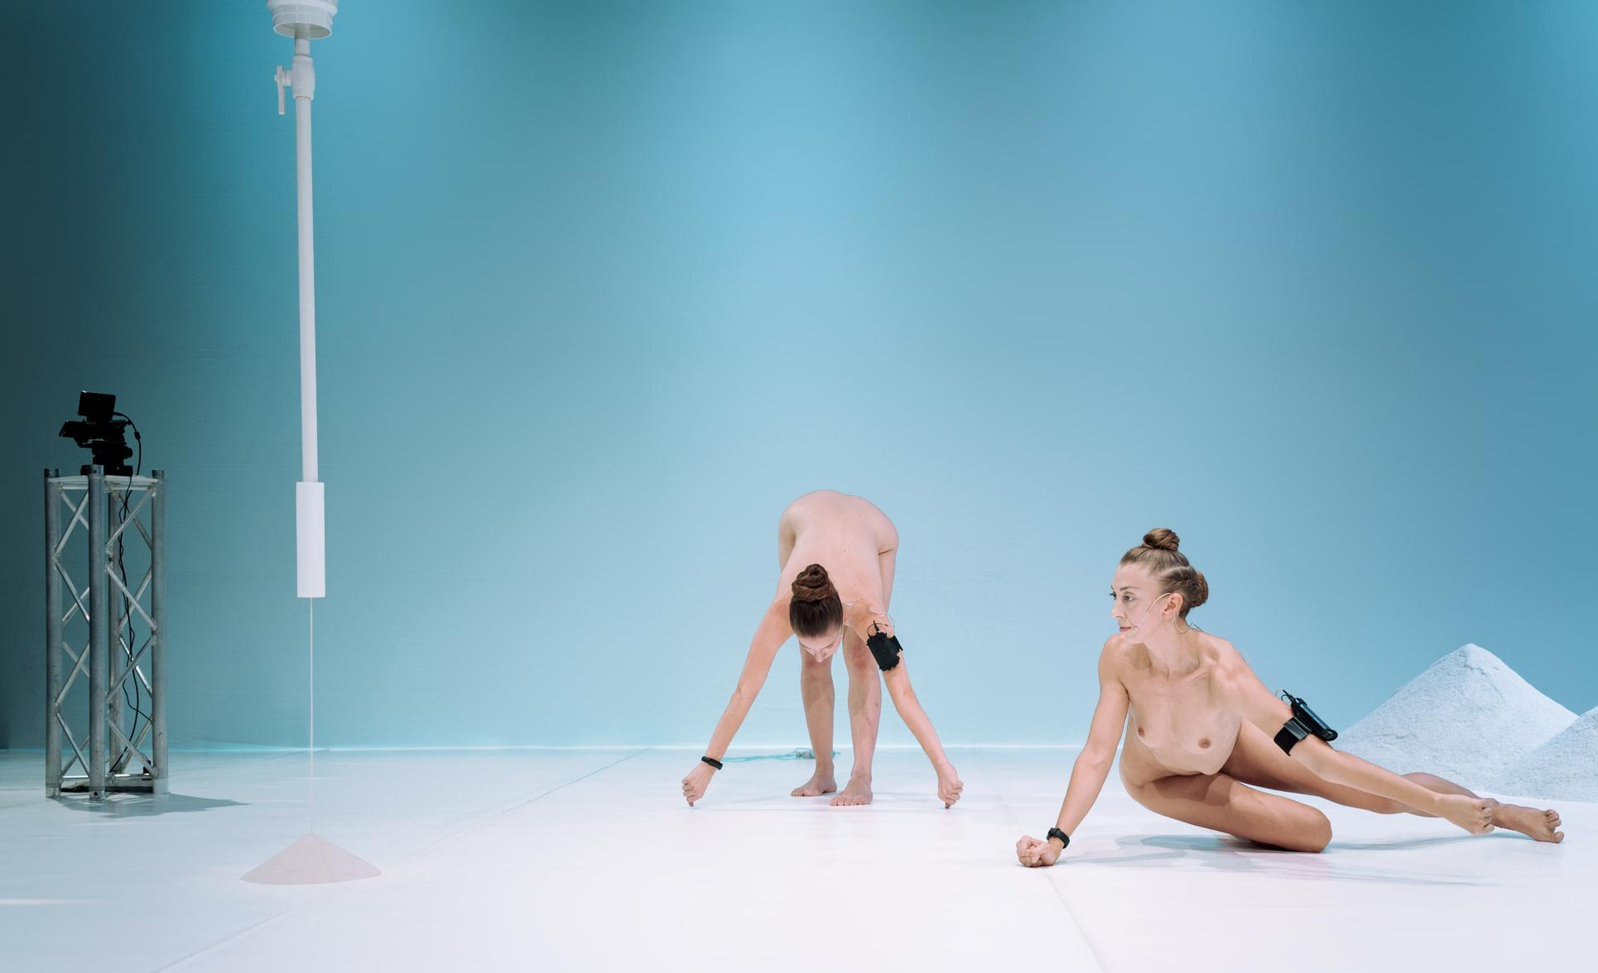
The story
BLOT is about the invisible world inside our bodies. Trillions of bacteria live on our skin and in our organs, helping us digest food, fight illness, and stay healthy. The performance explores how these tiny organisms shape who we are and connect us to the world around us. Using movement, words, and images, the show reveals the surprising ways bacteria influence our breath, sweat, and even emotions. It invites us to see the human body not as something separate but as a living system, always changing and working together with the microscopic life within it.

Slide 5
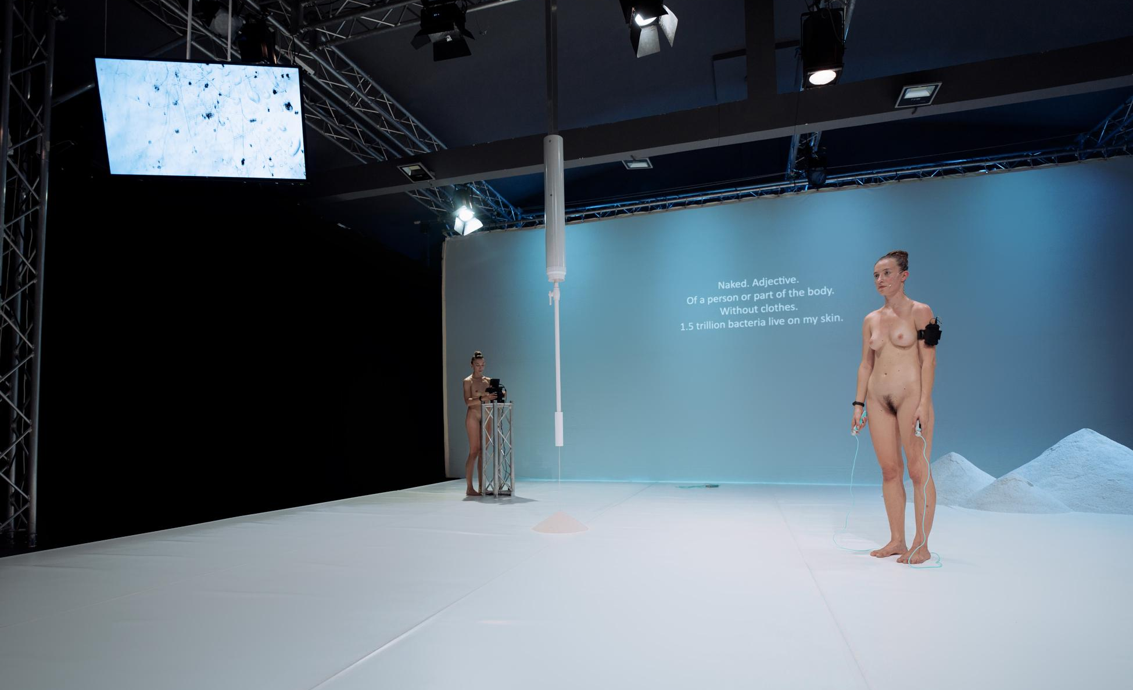
The Set
The performance has a very clean and clear set with white dance floor and white background. Sometimes, depending on the venue, the background can be a wall. On this background surtitles and open captions are projected.
The set is also composed by:
Three (or four) piles of salt placed on the right side of the back of the stage;
A white, tube-like object from which fine sand pours at a specific moment during the show;
A microscope on a stand on the right side of the back of the stage;
A flat TV, hanged from the ceiling, on the right side of the front of the stage.
Two skipping ropes at the back of the stage and on the left edge

Slide 6
The Performers
The piece is performed by two female dancers who are completely nude. They wear black hand-bands with microphone transmitters and light beige headsets, and their hair is tightly styled.
Throughout the show, they call each other by name— Luiza and Simona.
They begin the performance already on stage in various postures and remain on stage until the end.
They do not approach the audience. If the venue is small, they move to the front stage and can be very close to the audience.
During the applause, they cover themselves with black robes.
LUZIA
SIMONA

Slide 7
Lights / Video / Sound
LIGHTS:
There is one light cue featuring a white, evenly distributed light at normal intensity, with the background illuminated in cyan. During the audience's entrance, the seats are lit, but this lighting will be dimmed once the performance begins.
VIDEO:
White surtitles and open captions are projected on the background for the entire show. The TV displays a blurred white image that comes into focus at a specific moment, revealing microscopic views of bacteria.
SOUND:
The soundtrack features electronic ambient music with high vibrations, generated by analogue methods with varying frequencies and intensities, spoken text from the performers amplified through headset microphones, and prerecorded dialogue of the two performers layered over music. The volume of the sound is not louder than 80 Decibels.

Slide 8
Things you might find intense
NUDITY
The performers are completely naked throughout the show, and the audience sees them this way from the beginning. However, the performance is not about nudity as we usually think of it. It looks at the female body from a scientific and biological perspective, focusing on anatomy rather than cultural or social meanings. The setting feels like a laboratory, creating a neutral space where the body is simply a body—something natural, functional, and always changing.
SOUND INTENSITY
The music in the performance shifts between soft ambient sounds and moments of higher intensity. The show opens with electronic sounds, intensive, creating an atmosphere of tension and anticipation. The audience enters as the performers subtly move and music increases. After the first few minutes, the volume lowers, and the atmosphere shifts to something quieter and more minimal. Performers begin to speak while jumping rope, and the space is filled with silence. As the performance progresses, the electronic music swells again, intensifying. These fluctuations in sound mirror the body's internal rhythms—heartbeat, breath, and movement—making the performers’ presence feel more vivid. By the end, the music softens once more as the performers continue jumping rope, until the final, fading notes.

Slide 10
Dossier produced within the project Body Landscapes. An Ecofeminist Perspective.
Thank you!

